Slide 1
C++ Programming Today 2nd Edition By Barbara Johnston Chapter 4
Instructor: Rob Garner
Lecture Slides by Kelly Montoya and Rob Garner

Slide 2
Overview
Basic Function Characteristics
Types of functions
Calling and Called Functions
How to write functions
Return Statement
Function Calls
Function variables
Troubleshooting Functions
Overloaded Functions
Default Parameter Lists
Variable Scope
Multi-File Programs
String Stream Class
Common Errors With Functions

Slide 3
Multi File Programs
Describe how to use multiple files in a program.

Slide 4
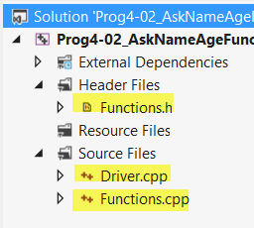
Multi File programs
Driver.cpp
Contains Main function
Functions.h
Function Prototypes
Functions.cpp
Function bodies

Slide 5
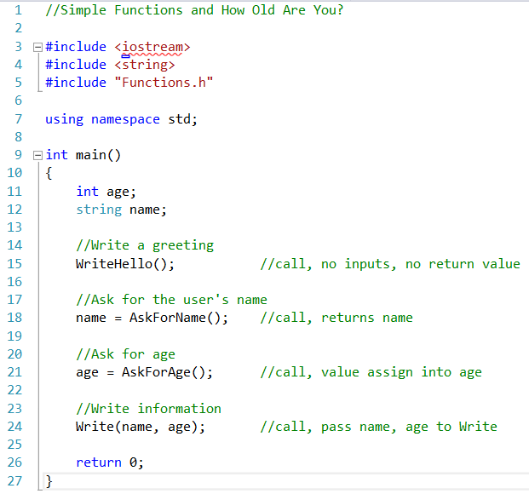
Driver.cpp
CPP file that typically has the main function where program execution begins.
Notice functions not defined here!
Instead it has:
#include “Functions.h”

Slide 6
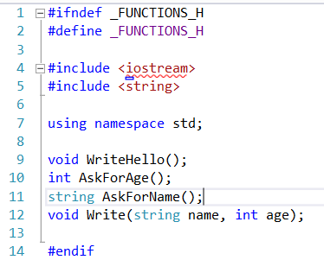
Functions.h
Contains function prototypes.
Does not contain function bodies!
What’s #ifndef and #define?

Slide 7
#ifndef and #define
Sometimes called an “include guard”
Some of our class may be used repeatedly in multiple libraries.
If the compiler reads the same file twice it can generate errors because it doesn’t automatically know it’s the same file!
Use #ifndef and #define to avoid this.
#ifndef _FUNCTIONS_H
#define _FUNCTIONS_H
//insert header file here
#endif
By convention we use this format. functions.h →_FUNCTIONS_H
mathfun.h → _MATHFUN_H
See http://www.cplusplus.com/forum/articles/10627/ for more info.

Slide 8
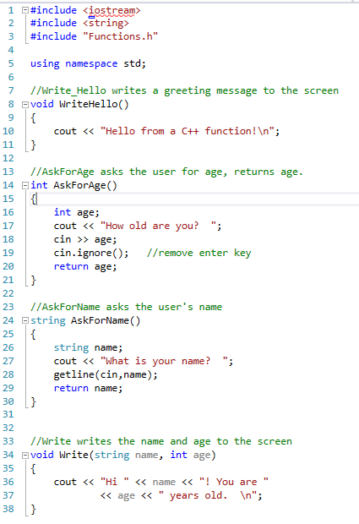
Functions.cpp
Contains the function bodies.
Notice it has:
#include “Functions.h”

Slide 9
Multiple Function Files
You can have multiple function.h and function.cpp files!
Give them different names.

Slide 10
What do we use #ifndef and #define for in a multi-file program?
To define a name for the program.
To prevent a Header file from being compiled multiple times.
To ensure the Header file is compiled each and every time it is referenced in an included library.
None of the above

Slide 11
Multi-File Demo
Demonstrate how to make multi-file programs.

Slide 12
String Stream Class
Explain how to use the string stream class.

Slide 13
The stringstream Class
The C++ stringstream class is a useful class when working with string and numeric data.
It is referred to as a stream object, and is found with the C++ input/output stream libraries.
You need to include the <sstream> header when you want to use a stringstream object.
Use the same formatting tools that we use with the cout object with a stringstream object.

Slide 14
The stringstream Class
When you need to write your program data into a string in a formatted manner, you’ll need to create a stringstream object and place your data into that object using the “<<” operator.
Then use the str() function to assign the contents into a string.
You can use all of the ios formatting flags that we have for cout with a stringstream object.
Notes:
Program 4-11 uses stringstream objects.

Slide 15
The stringstream Class
//Create a stringstream object.
stringstream ss;
// Variables we’ll use for the string
double pi = 3.141592653589793;
float dollar = 1.00;
int dozen = 12;
//use our usual cout "tools“ with ss.
ss << " A dozen is " << dozen << ", a dollar is $";
ss.setf(ios::fixed);
ss.precision(2);
ss << dollar << " and \n";
ss << "the value of pi to 10 places is ";
ss.precision(10);
ss << pi << ".";

Slide 16
The stringstream Class
//now we assign the contents of ss into a string
//use the str() function.
text = ss.str();
cout << "\n Here is our formatted text string:\n"
<< text << endl;
//Add one more piece of data into the formatted //string:
ss << "\n There are 2 \"+\"s in C++.";
text = ss.str();
cout << "\n Here is the final string: \n" << text << endl;

Slide 17
Output
Welcome to the StringStream Demo program.
Here is our formatted text string:
A dozen is 12, a dollar is $1.00 and
the value of pi to 10 places is 3.1415926536.
Here is the final string:
A dozen is 12, a dollar is $1.00 and
the value of pi to 10 places is 3.1415926536.
There are 2 "+"s in C++.

Slide 18
Write code to instantiate a stringstream variable called bankBal and initialize it to “Bank balance: “ concatenated to a float called floatBal. Format the result so that it shows two decimal places of precision after the decimal point.

Slide 19
Common Errors With Functions
Describe common errors with functions.

Slide 20
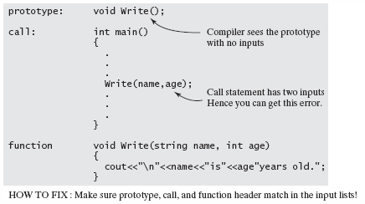
Common Errors With Functions
Compiler Error: function does not take __ parameters.
The function prototype and call statements do not match in the input lists.
Notes:
Program 4-11 uses the stringstream class.

Slide 21
Link Error: unresolved external: void _decl
Write(class string, int age)
The prototype, call statement and function header lines have to match.

Slide 22
Compile Error: missing function header
(old-style formal list?)
Leaving the semi-colon on the function header line generates this error.

Slide 23
Review
Functions require two “sets” of statements: a prototype or declaration, and a function definition—which is the actual function code. The first line of the function is named the function header line.
The function prototype, or declaration, and function header line are almost identical.
They contain the return data type and input data type variable, list parameters.
The call statement is the location where the function is actually called.

Slide 24
Review
The call requires only variable names.
If a value is returned, it should be assigned into a variable.
Functions can be overloaded, meaning that two or more functions can have the same name but they must have different input parameter lists.
The function prototype can have default values assigned to the input variables. When you have default values you do not need to have values or variables in the call statements.

Slide 25
Review
Global variables are declared outside any function and are seen by all functions in the file.
Local variables are declared inside the function or in the function header line and are only accessible within the function.
Static variables are local variables that retain their value after the function is exited.

Slide 26
Overview
Basic Function Characteristics
Types of functions
Calling and Called Functions
How to write functions
Return Statement
Function Calls
Function variables
Troubleshooting Functions
Overloaded Functions
Default Parameter Lists
Variable Scope
Multi-File Programs
String Stream Class
Common Errors With Functions

